Slide 1

Long Products: Good Stow Guide 2022
More than Ports

Slide 2

Contents
Contents:
  Slide 3: Introduction
  Slide 4: Steel Coils
  Slide 7: Wire Rod in Coil
  Slide 10: Rebar
  Slide 16: Steel Plate
  Slide 21: Scaffold
  Slide 25: H Beam

Slide 3
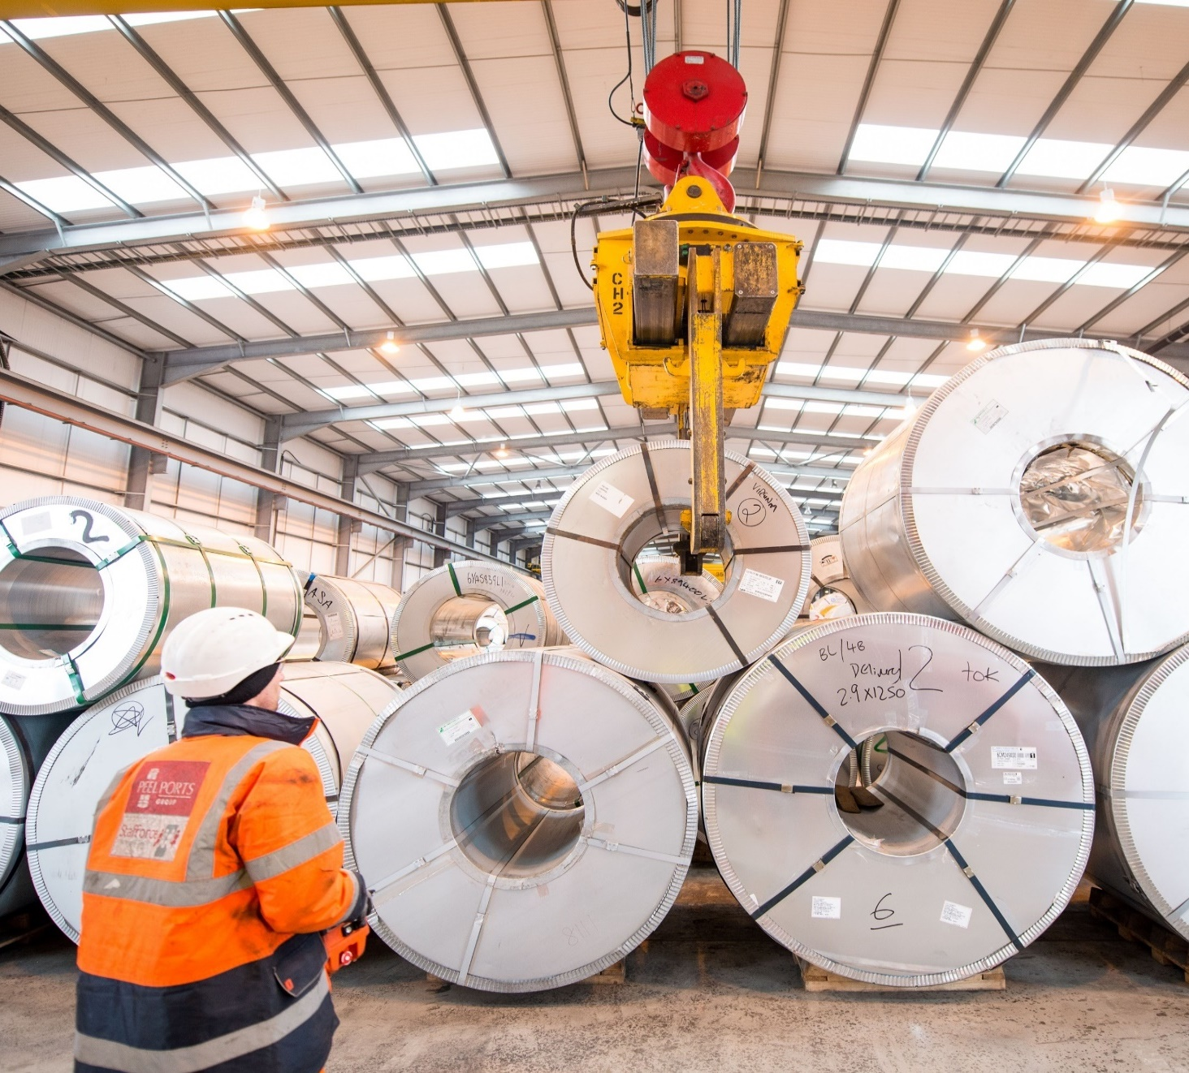
Introduction
The primary objective of these guidelines is to ensure:
• The safety of all personnel engaged in cargo operations at Peel Ports.
• Expeditious discharge, resulting in efficient productivity and turn-round in the cargo handling operation at the disport.
• Avoidance of damage to the cargo during the cargo handling operation.
From a Health & Safety perspective, the driver is to safeguard our stevedores and contractors at all times, providing the safest environment possible for them to operate in.
Peel Ports’ sites in the UK request that this guide is followed at all times to ensure the safety of our stevedores and contractors when discharging cargo.

Slide 4

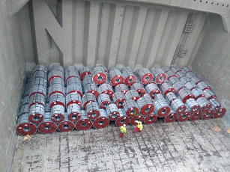
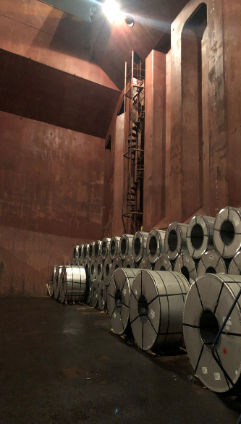
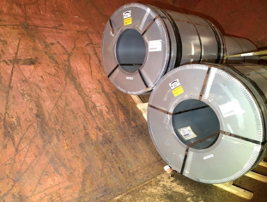

Steel Coil
BOX HOLD VESSELS -This allows easy access to all coils using ship’s gear and minimises requirement for coil probe truck. This also avoids coils being stowed on hopper sides which are difficult to handle and increase potential to damage.
Bottom tier coils to be chocked BOTH sides
Coils in excess of 14t to be stowed clear of overhanging coamings. In addition to increases health and safety risks, expensive mobile cranes are required to discharger heavy (over 14t) coils from under coamings increasing costs to shipping lines/receivers.
Spacing of 15cm between coil rows.
No 14MT+ coils to be stored under wings/coamings at any time.
Mixing of coil widths within any one row to be avoided if possible

Slide 5

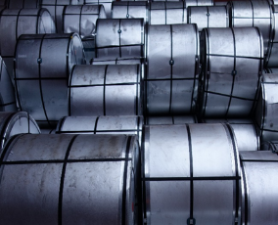
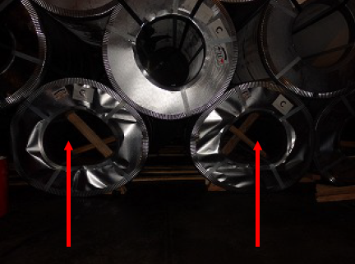
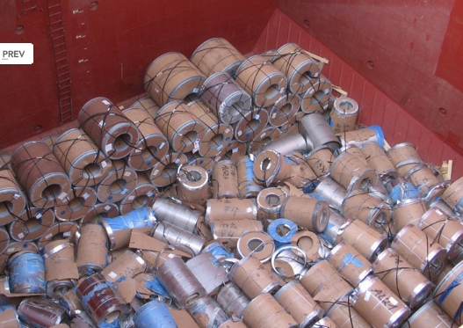
Steel Coil
Example of coils stowed hard up to each other restricting/preventing easy access of slings used in discharging operations.
Ovalised coils as a result of poor/uneven weight distribution.
Poor loading can often result in cargo movement resulting in collapsing of stow.

Slide 6

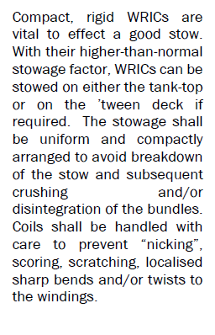
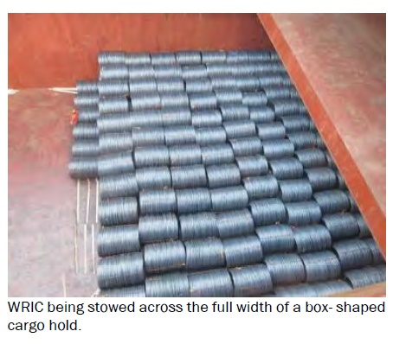
Wire Rod (In Coil)
BOX HOLD VESSELS -This allows easy access to all coils using ship’s gear and minimises requirement for coil probe truck. This also avoids coils being stowed on hopper sides which
are difficult to handle and increase potential to damage.
Bottom tier coils to be chocked BOTH sides
Spacing of 15cm between coil rows

Slide 7
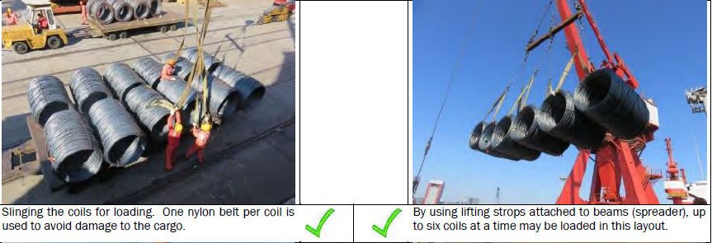
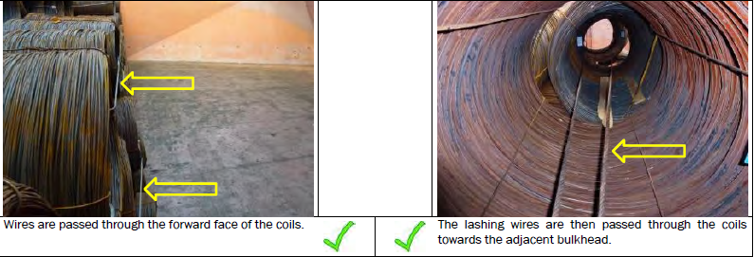
Wire Rod (In Coil)

Slide 8
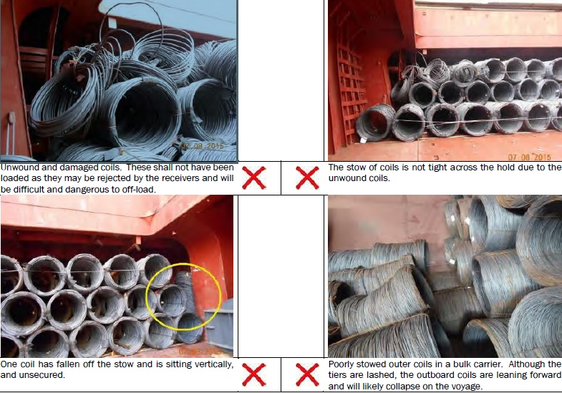
Wire Rod (In Coil)

Slide 9
Wire Rod (In Coil)
SUMMARY CHECKLIST
Boxed shaped vessel (no winged vessels)
Plywood dunnage of at least 10mm thickness shall be used on the tank-top and wooden planks of approximately 15mm x 100mm cross-section for the bulkheads and, if required, between tiers.
The height of the stow should be three tiers maximum
For part hold loading, the cargo shall be loaded against the aft bulkhead.
The WRICs shall not be overloaded with other cargoes.
For partly stowed cargoes, front rows adjacent to the face are to be pre-slung. This will assist the off-loading in the event of collapsing of the stow in transit. (The number of tiers depends on the maximum height that a forklift truck can take them.)
In the cargo compartments, where possible, safe passage shall be provided directly from the ladders to the top of the cargo stow. Safe access shall also be provided from the tank-top to the top of the cargo stow.

Slide 10
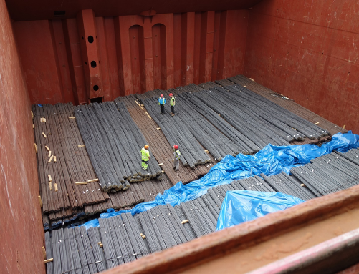
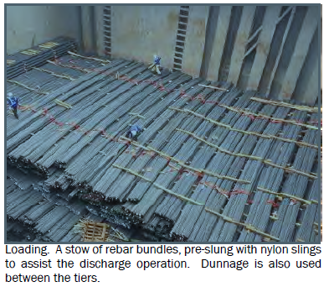
Rebar
Preference for vessels with box shaped holds
It is essential that slings are clearly and correctly labelled and matching EU certification standard.
Sling eyes to be unobstructed/clearly accessible
Dunnage placed between each tier of rebar, preferred at 2.5 metre intervals
We cannot lift bundles direct from wire fasteners for obvious health and safety reasons.

Slide 11
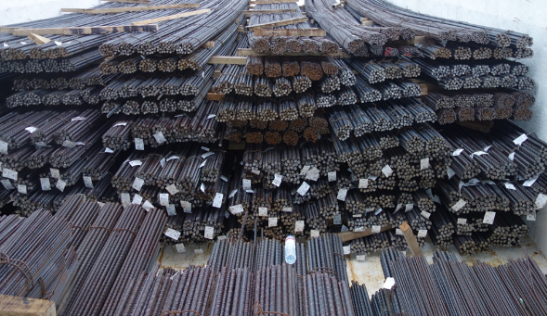
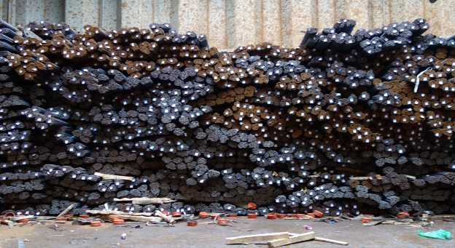
Rebar
Well applied, timber dunnage (size 2400cm x 13cm x 13cm) creates even tiering which assists in discharge operations.
Lack of / inadequate dunnage results in ill-defined tiering which leads to delays / extra handling during discharge operations.
Admixing/Combining of sizes in stow to be avoided/minimised where possible

Slide 12
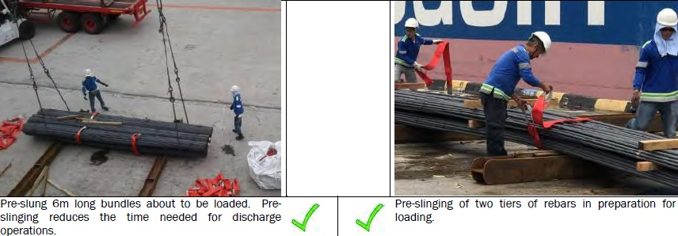
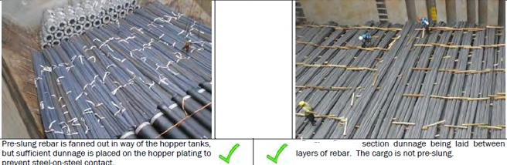
Rebar

Slide 13
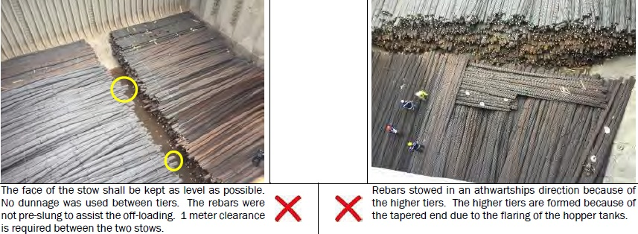
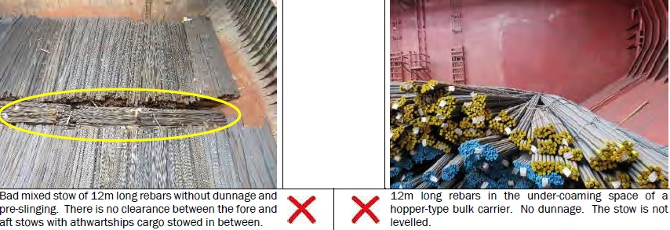
Rebar

Slide 14
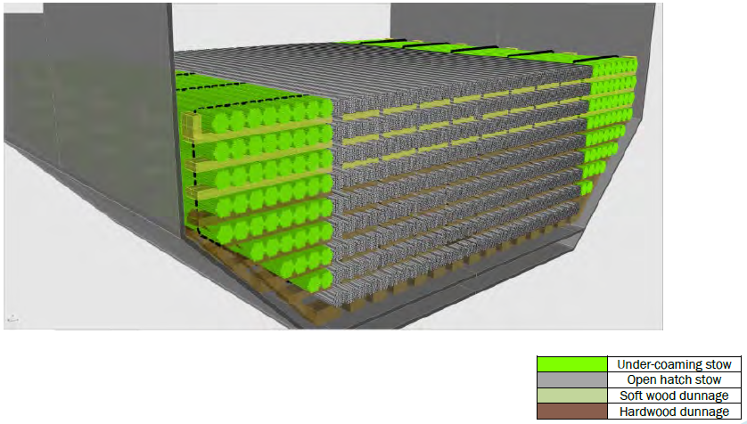
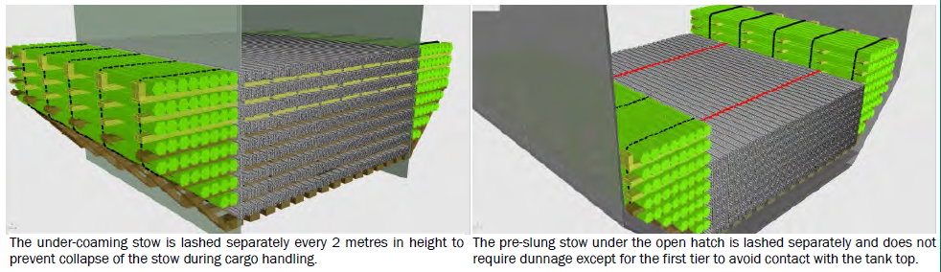
Rebar

Slide 15
Rebar
SUMMARY CHECKLIST
Tank-top load limits not to be exceeded. Consideration to be given to the hopper areas, where the load limits may be smaller.
Tank-top to be prepared with appropriate dunnage to prevent steel-to-steel contact. Lashings to be pre-positioned on the tank-top.
Maximum distance between rows of timber dunnage to 2.5m intervals
Dunnage on the tank-top to be hardwood with minimum cross-section 2400cm x 13cm x 13cm
Dunnage between layers to be laid to assist with slinging at discharging ports.
Dunnage is required for the under-coaming space areas. If the rebars within the open hatch area are pre-slung, then dunnage is required only at the tank-top and not for the tiers.
Separate lashing of the under-coaming cargo stow may be required to prevent the stow from collapsing during off-loading of the open hatch stowed cargo of rebars.
All tiers to be stowed level, the face of the stow to be as straight as possible, with sufficient clearance from the adjacent stow to prevent virtual over stows.
In the cargo compartments, where possible, safe passage shall be provided directly from the ladders to the top of the cargo stow. In bulk carriers this access shall be provided directly from the Australian ladders. Safe access shall also be provided from the tank-top to the top of the cargo
stow.

Slide 16
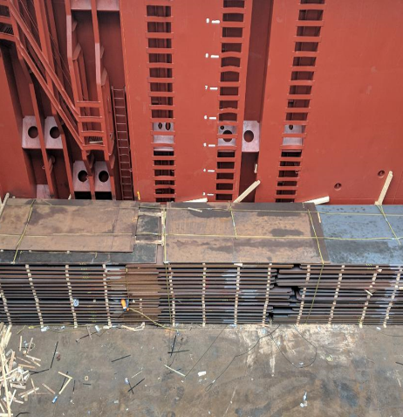
Steel Plate
Preference for box shaped holds
Plates to be stacked in neat, flush-edged lifts of circa 15t
Lifts to be stacked, suitably dunnaged and with sufficient spacing at long edges to allow plate clamp access
If vessel has coamings then smaller plates should always be loaded underneath.
Long, thin gauge plate under coamings requires two trucks in the hold to discharge with tandem lift, significantly increasing potential damage to plates.

Slide 17
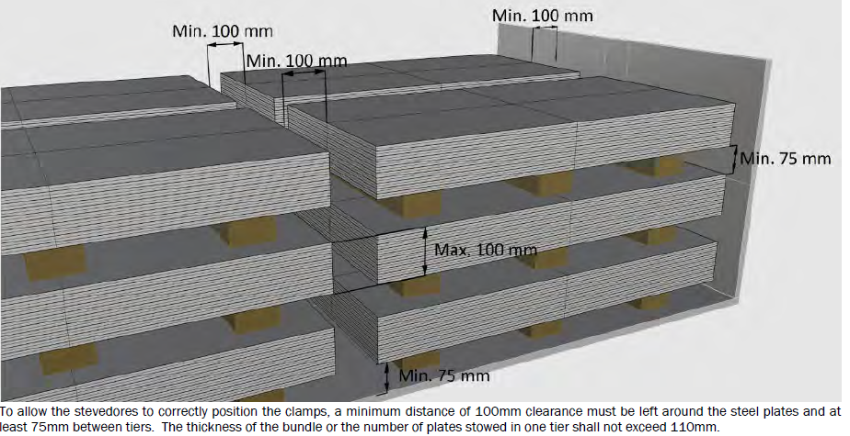
Steel Plate
.

Slide 18
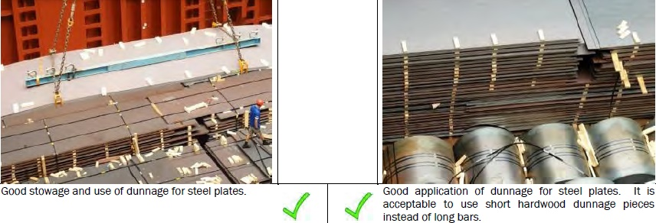
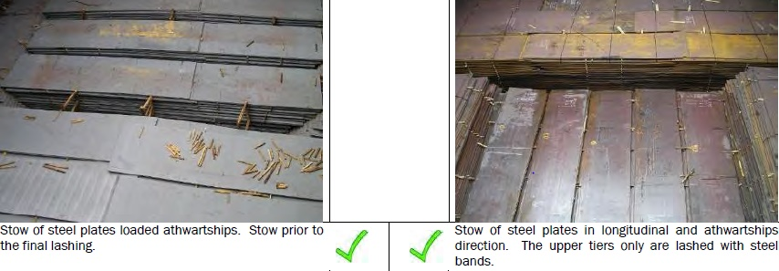
Steel Plate
.

Slide 19
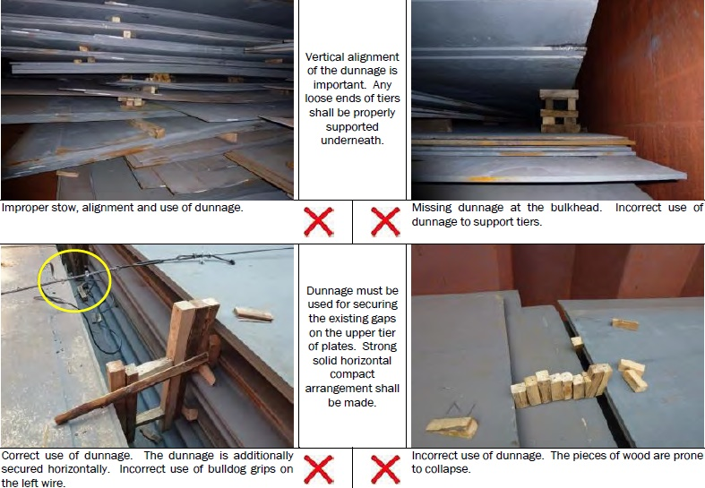
Steel Plate
.

Slide 20
Steel Plate
SUMMARY CHECKLIST
• Tank-top load limits not to be exceeded. Consideration to be given to the hopper areas, where the load limits may be smaller.
• Tank-top to be prepared with appropriate hardwood dunnage to prevent the steel plate bending or buckling. The spacing of the dunnage should be at 2.5 metre intervals. Shorter pieces may also be used.
• Dunnage between tiers to be laid in a vertical line to prevent waviness in the steel plate.
• Lashing wires at a spacing not more than 3 metres to be positioned on the tank-top in preparation for the final lashing of the stow.
• The full stow may be lashed in one block. Alternatively, the last two tiers or the last tier of steel plates shall be lashed.
• Separate tiers or bundle heights (between horizontally placed dunnage beams) shall not exceed 110mm.
• A minimum clear distance of 100mm is required between edges of the steel plates and adjacent cargo or bulkheads. This distance shall be properly dunnaged.
• All tiers to be stowed level.
• In the cargo compartments, where possible, safe passage shall be provided directly from the ladders to the top of the cargo stow. In bulk carriers, this access shall be provided directly from the Australian ladders. Safe access shall also be provided from the tank-top to the top of the cargo stow.
.

Slide 21
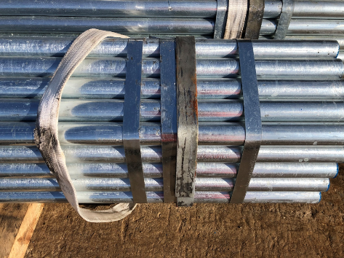
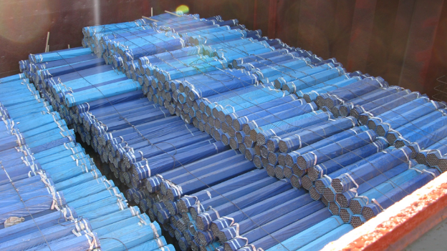
Scaffold
Preference for vessels with box shaped holds
Endless slings - it is essential that slings are clearly and correctly labelled and matching EU certification standard (see slide 24)
Welded metal end brackets afforded to each end of every bundle

Slide 22
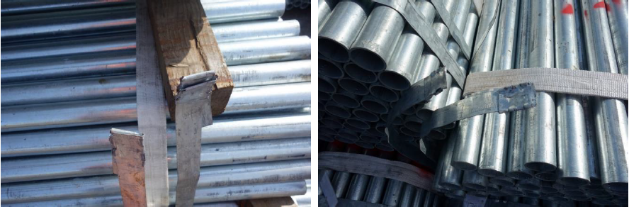
Scaffold
Examples of failed clips which can result in cargo damage and slower discharge. Failed clips are the result of poor stowage and/or inadequate “crimping” of scaffold bundles before being loaded. This is further reason why welded metal brackets (see slide 16) should be afforded to each and every bundle.

Slide 23
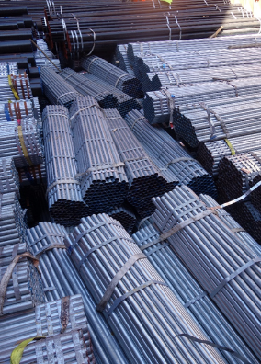
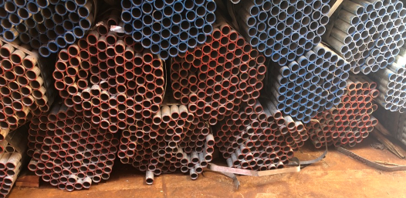
Scaffold
Height of stow to be restricted both in terms of safe working and avoidance of compression damage to lower tier bundles
Examples of poorly stowed bundles resulting in settlement/shifting presenting difficulties at the time of discharge.
Admixing/Combining of sizes in stow to be avoided/minimised where possible

Slide 24
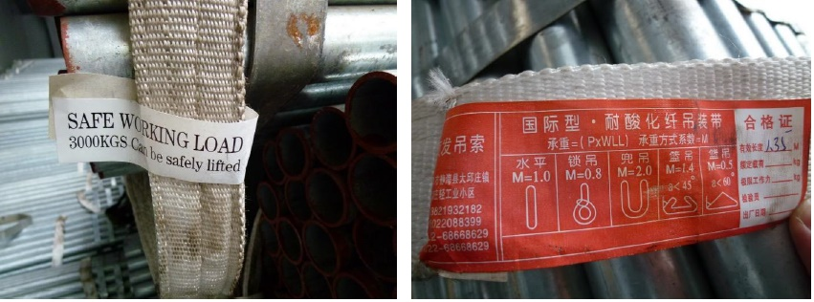
Scaffold
Lifting slings must be clearly labelled in English with (EU) appropriate certification and matching labels. Any deviation from the above could result in a slower discharge (not using lifting slings) and additional costs. Please refer here for additional guidance:
http://www.hse.gov.uk/work-equipment-machinery/loler.htm

Slide 25
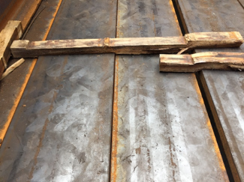
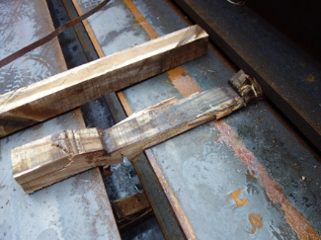
H Beam
Preference for box shaped holds
Each tier of beams to be adequately dunnaged using 110 x 110mm hardwood timbers, set at 2.5m intervals
Poor quality, small section dunnage is prone to compression due to over stowing weight which renders it difficult/more time consuming for discharge operations.

Slide 26
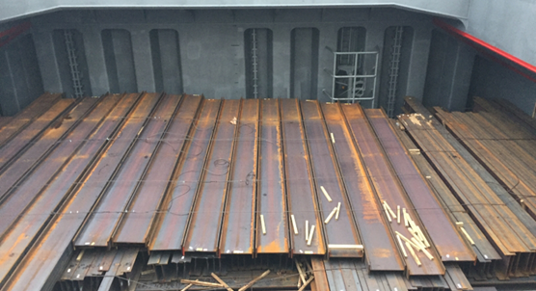
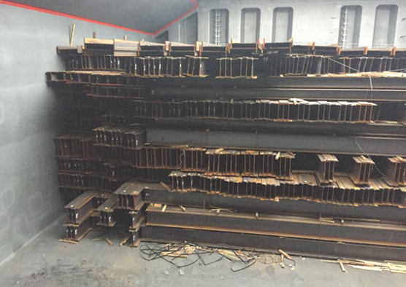
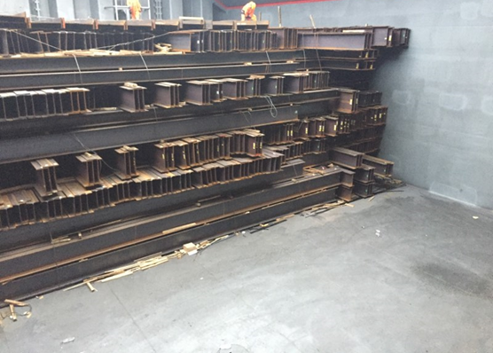
H Beam
H-Beam, block stowed against the aft transverse bulkhead to half-hatch, lengths fore to aft approximately 8 metres high. The stow appeared to be well dunnaged. The hold was straight sided in the way of the stow (there were no hopper sides in the lower portion) which led to an even and uniform stow.

Slide 27
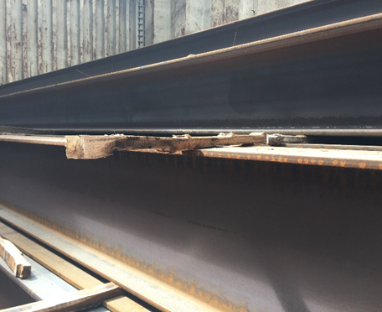
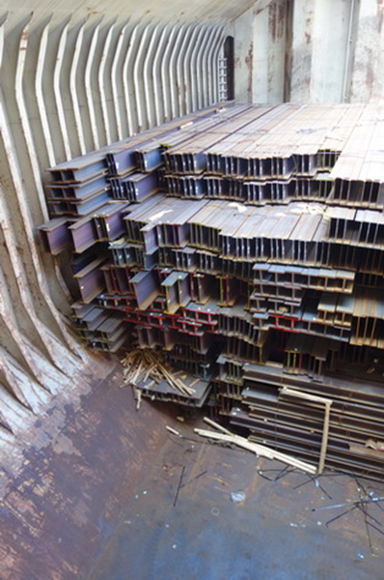
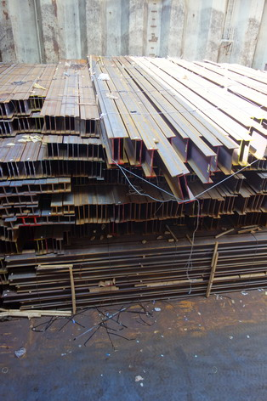
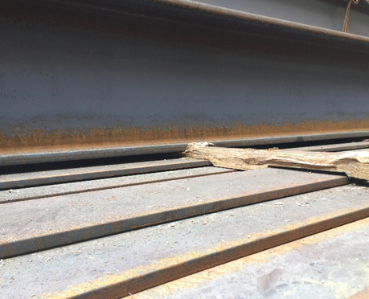
H Beam
Softwood/unsuitable dunnage –
As discharge progressed it was found that the dunnage became progressively more compressed the further down the stow, with lower tier dunnage compressed to 35mm, significantly reducing forklift tine access.
Potential issues when beams loaded to vessel with hopper sides, i.e. slight settlement of wing stowed bundles resulting in slower discharge.

Slide 28
Thank you
More than Ports

